Slide 1
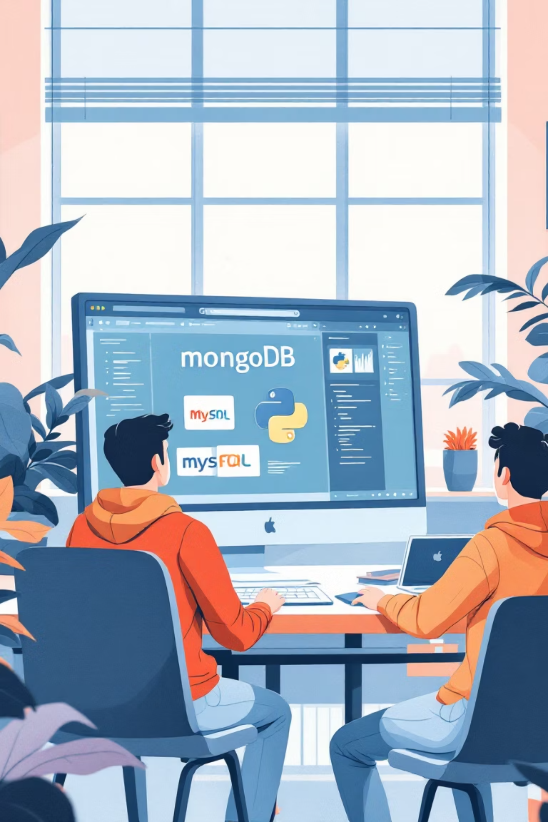
MongoDB Workshop
3rd-Year Computer Engineering Workshop
Instructor: Tejas Nalawade
Master database integration with practical, real-world examples

Slide 2
Session Agenda
Let's dive into database fundamentals and hands-on development! Here's our roadmap for today's interactive workshop.
01
02
03
Introduction to MongoDB & SQL
Quick Quiz: Test Your Knowledge
CRUD Operations & Python Integration
Understanding the differences between relational and document databases
Interactive assessment of your current database understanding
Hands-on coding with both database types
04
05
06
Flask API Demo
Streamlit Mini Project
Quiz & Concept Discussion
Building RESTful APIs that connect to multiple databases
Creating a complete student management application
Reinforcing key concepts through interactive Q&A
07
Hands-on Assignment
Apply everything you've learned in practical exercises

Slide 3
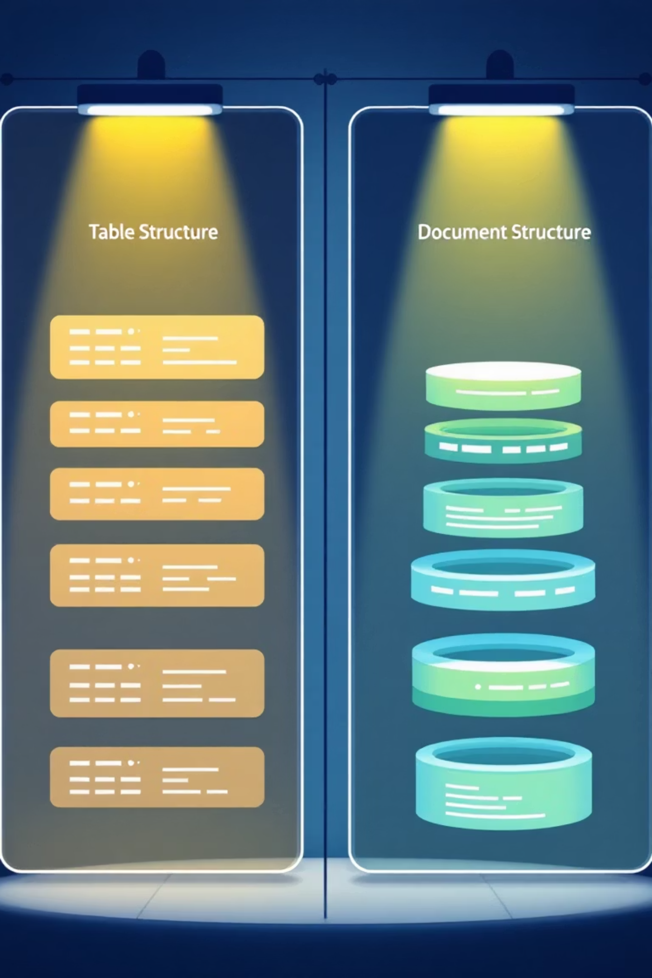

Why Use Both NoSQL & SQL?
Different data types require different storage solutions. Let's explore when to use each approach.
SQL Databases
MongoDB (NoSQL)
Structured tables with fixed schema
Flexible, JSON-like documents
Strong relationships and constraints
Dynamic schema adaptation
Perfect for consistent, predictable data
Excellent for varying data structures
Rapid development and iteration
ACID compliance for transactions
Best for: User preferences, logs, content management
Best for: User profiles, financial records, inventory
LinkedIn Example: User name and email stored in SQL for structure, while skills and notes live in MongoDB for flexibility!

Slide 4




MongoDB Overview
MongoDB stores data as documents in collections, making it perfect for flexible, rapidly-changing applications.
Document-Based Storage
Collections Instead of Tables
Data stored as JSON-like BSON documents with nested fields and arrays
Groups of documents stored together, no fixed schema required
Core CRUD Operations
insertOne(), find(), updateOne(), deleteOne() for data manipulation
"MongoDB's flexibility allows developers to adapt their data model as requirements evolve, without complex migrations."

Slide 5

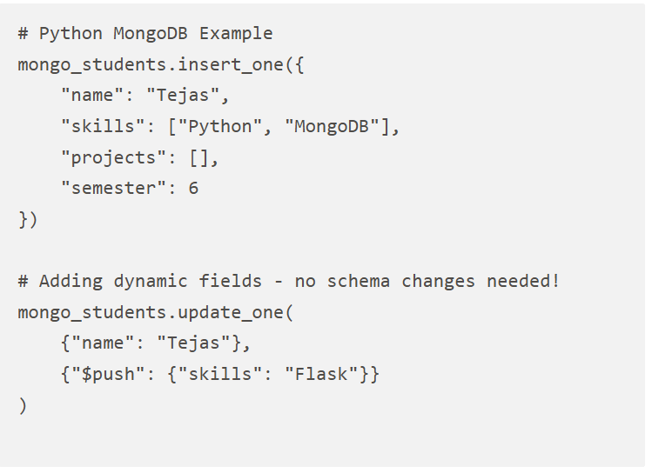

MongoDB Demo
Let's see MongoDB in action! Watch how we insert and manipulate document data using Python and PyMongo.
Live Compass View
Watch documents appear instantly in MongoDB Compass interface
Dynamic Field Addition
Use $push operator to add elements to arrays without restructuring

Slide 6
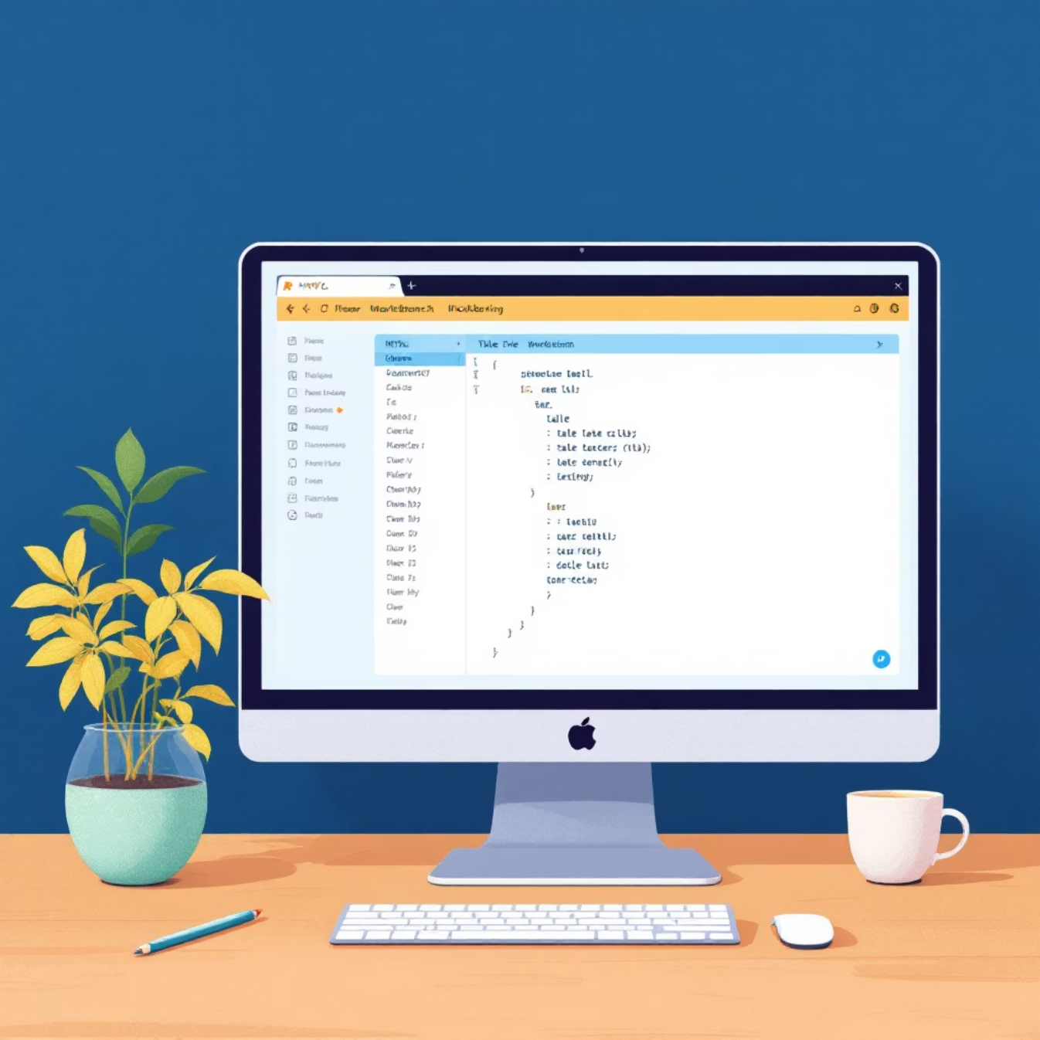
MySQL Overview
MySQL provides structured, reliable storage with strong relationships and data integrity guarantees.
Key Features
Structured Tables: Fixed rows and columns with defined data types
SQL Queries: SELECT, INSERT, UPDATE, DELETE operations
Data Integrity: PRIMARY KEY, UNIQUE, FOREIGN KEY constraints
Relationships: JOIN operations across multiple tables
Perfect for applications requiring consistent data structure and complex relationships.
ACID Compliance
Ensures data consistency and reliability across all transactions
Mature Ecosystem
Extensive tooling, optimization, and community support

Slide 7

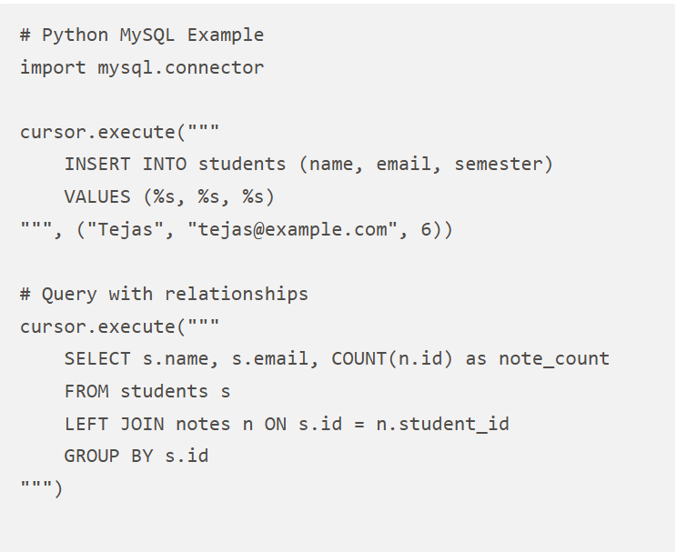
MySQL Demo
Experience the power of structured data with SQL operations. See how relational constraints maintain data integrity.
Watch how foreign key relationships maintain data consistency across tables!

Slide 8
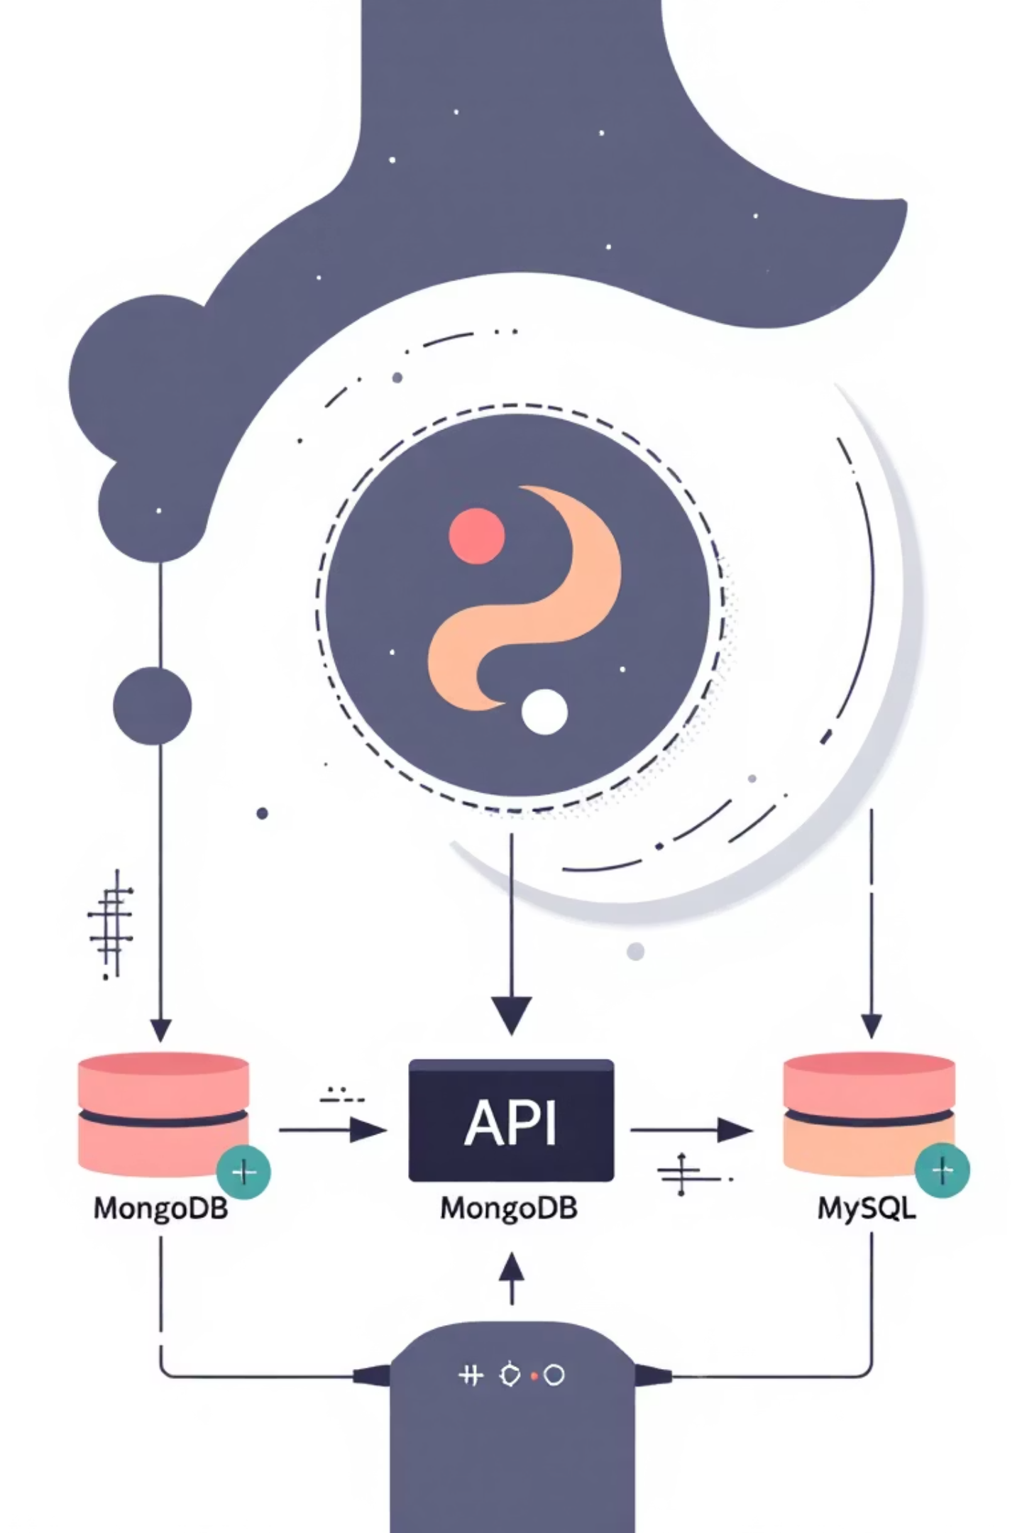



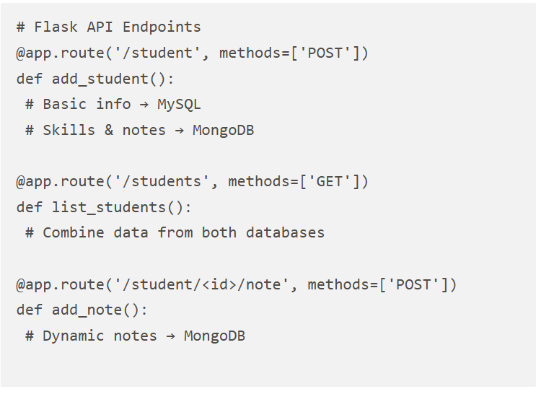
Python Integration with Flask API
Connect both databases through a unified Flask API. Create endpoints that leverage the strengths of each database type.
Flask Routes
RESTful endpoints handling HTTP requests
Dual Connections
MongoDB & MySQL connections in single application
Smart Data Routing
Structured data to MySQL, flexible data to MongoDB

Slide 9
Streamlit Mini Project & Hands-On Activity
Build a complete student management system combining everything we've learned. Your turn to code!
Interactive Dashboard
Your Challenge
User-friendly interface for managing student data across both databases
Add students, create notes, and watch live database changes in real-time
1
Add a New Student
2
Create Dynamic Notes
Insert structured profile data into MySQL and initialize MongoDB document
Add flexible notes and tags using MongoDB's document flexibility
3
List All Students
4
Observe Database Changes
Query both databases and display combined results in Streamlit
Monitor real-time updates in MongoDB Compass and MySQL Workbench
Ready to become a full-stack database developer? Let's code!

